Slide 1



fullstackdatascience.com
Introduction
Get to know the role of a Data Analyst
Created by HuyNT
DA K6
Lesson 1
huynt@fullstackdatascience.com
1

Slide 2

Learn
About
00/
Data
01/
Database
02/
Data analysis
03/
Data Positions in a company and BI Tools
fullstackdatascience.com
2

Slide 3
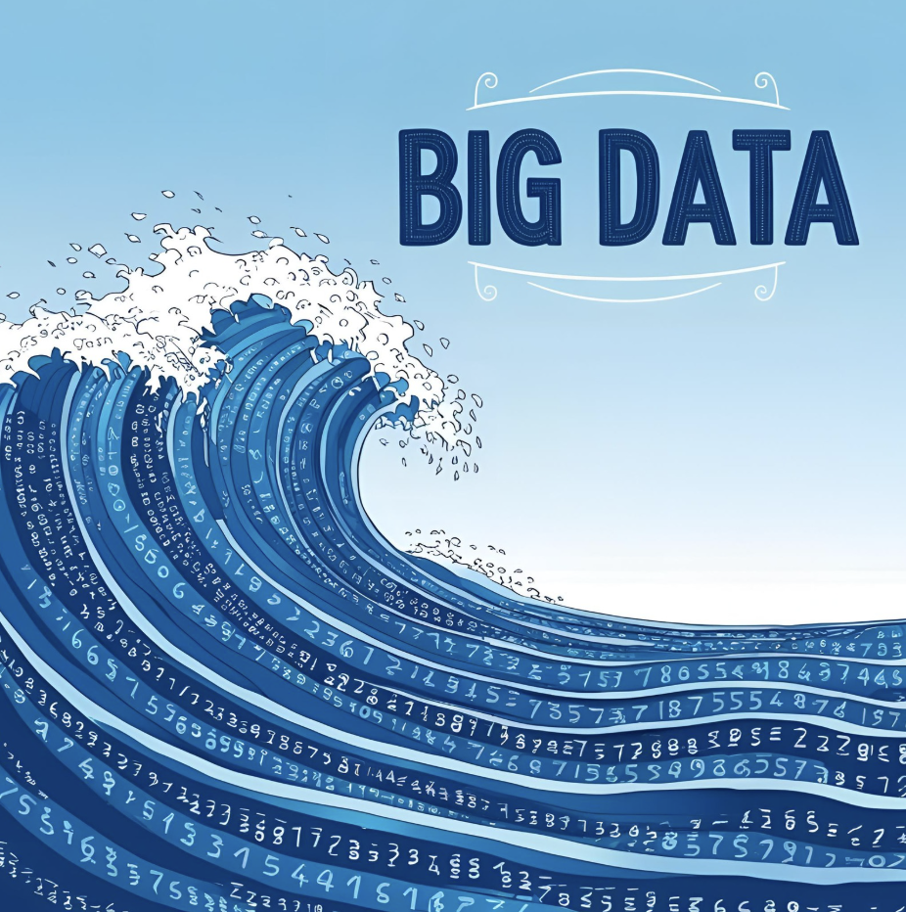
Data
Introduction
Data is raw information that represents facts, figures, observations, or measurements collected from various sources. It can be structured (organized in tables, databases) or unstructured (text, images, videos, etc.).
3

Slide 4
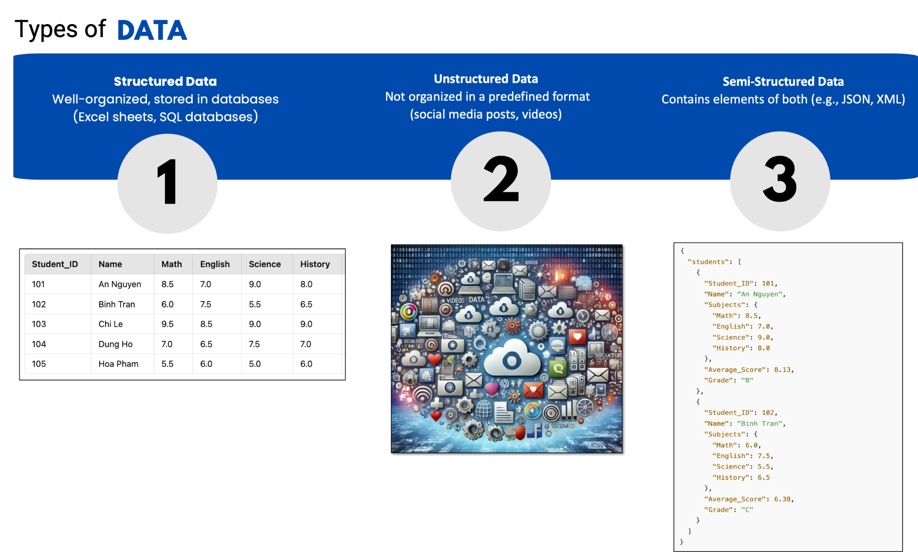
4

Slide 5
Compare
Feature | Structured Data | Semi-Structured Data | Unstructured Data
Definition | Data stored in a fixed format, following a strict schema. | Data that has some structure but is flexible. | Data without a predefined structure.
Examples | Relational databases (SQL), spreadsheets. | JSON, XML, NoSQL databases, emails, CSV with missing fields. | Images, videos, audio, PDFs, social media posts.
Storage | Stored in tables with rows and columns. | Stored in key-value stores, document-based systems. | Stored as files (binary, multimedia, raw text).
Schema | Strictly defined schema (e.g., relational database schema). | Loose schema, metadata helps define structure. | No predefined schema.
Querying | Can be queried using SQL. | Queried with NoSQL, XPath, JSONPath, etc. | Requires advanced techniques like NLP, AI, or metadata-based search.
Flexibility | Rigid (difficult to change schema). | More flexible (can accommodate new attributes easily). | Highly flexible but harder to manage.
Processing | Easy to process using SQL and analytical tools. | Requires parsing and transformations. | Complex processing (AI, ML, OCR, speech-to-text).
Storage Size | Most efficient in storage as data is structured and optimized with indexing and compression. | Takes more storage than structured data due to metadata and key-value format. JSON, XML are bulkier than CSV. | Requires the most storage, especially for media files like videos, images, and audio. Can range from MB to TB per file.
Use Cases | Business applications, banking, CRM, ERP. | Web data, IoT logs, emails, JSON-based APIs. | Multimedia, social media analysis, data lakes.
5

Slide 6
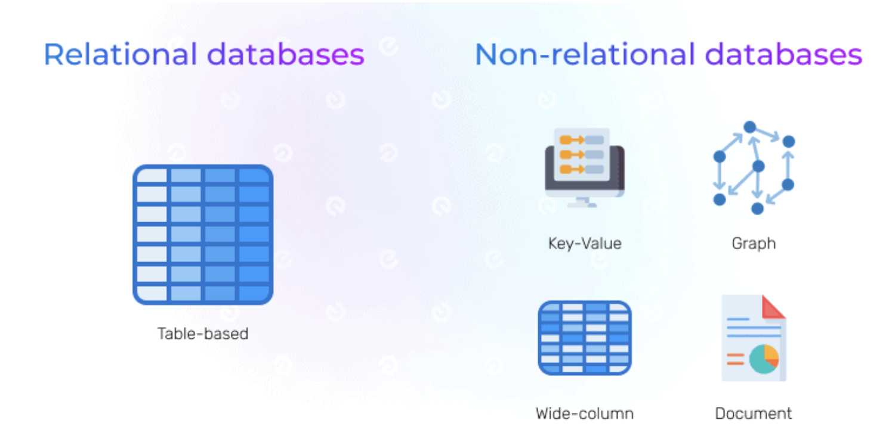
Database
6

Slide 7
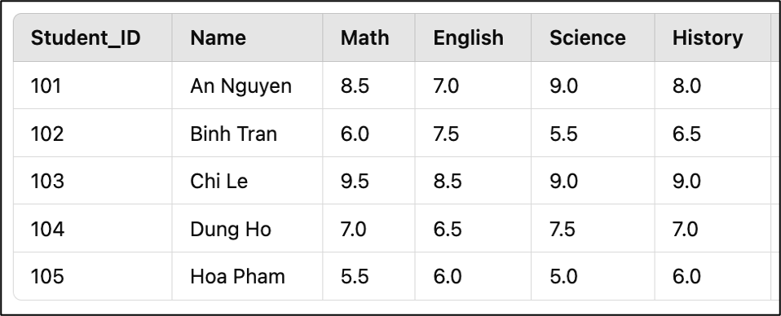
Relational Databases
Table
Data is organized into rows (records/tuples) and columns (fields/attributes).
Each row represents a single record - Entity.
Each column represents a specific attribute of the record.
7

Slide 8
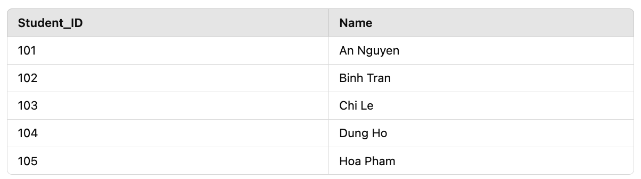
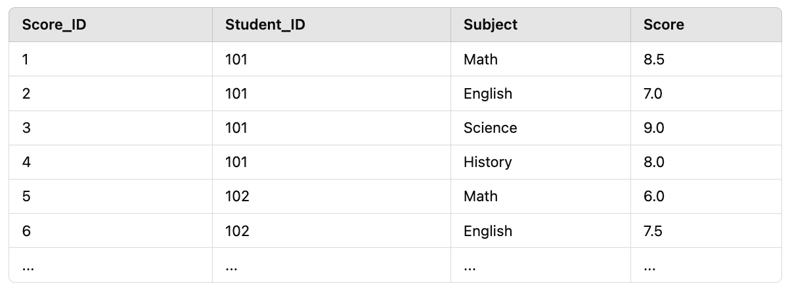
Relational Databases
Primary Key - Foreign Key
Each table has a primary key that uniquely identifies each record.
Ensures there are no duplicate rows in the table.
Relation
A foreign key is a column that references the primary key of another table.
Used to establish relationships between tables in a relational database.
8

Slide 9
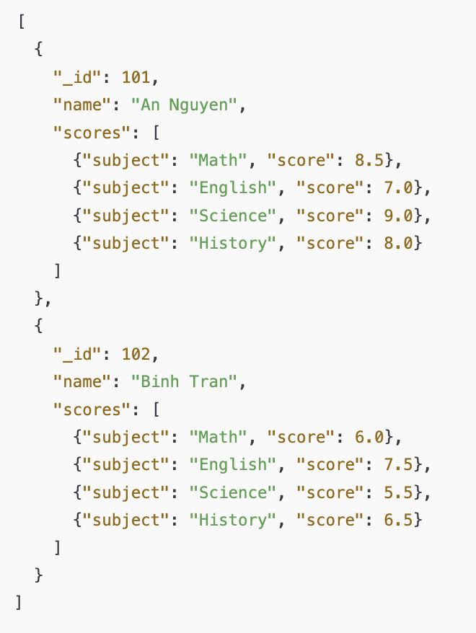
Non-Relational Databases
JSON
Document-based data: Each student has a document containing all related information, including scores, instead of being split into Students and Scores tables.
No need for JOINs: In SQL, you need to JOIN the Students and Scores tables to retrieve data, but in MongoDB, a single query can fetch all the necessary details.
Flexible schema: Each document can have a different structure without affecting the entire database.
9

Slide 10
Relational vs Non-relational Databases
SQL
NoSQL
Financial & Banking Systems
Booking Systems
E-commerce Order Management
Real-time Applications
Big Data & Large-scale Analytics
Social Media
10

Slide 11
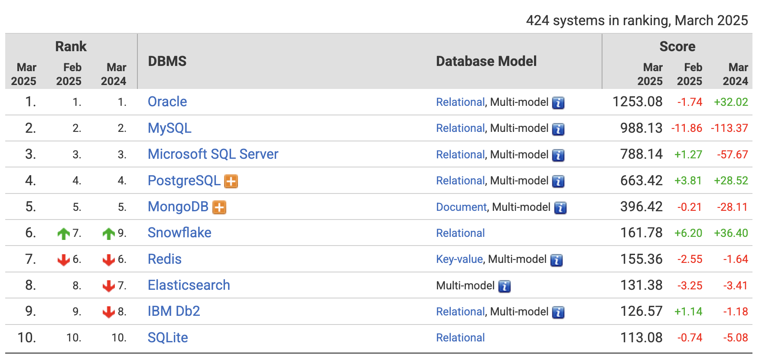
Database Ranking
11

Slide 12
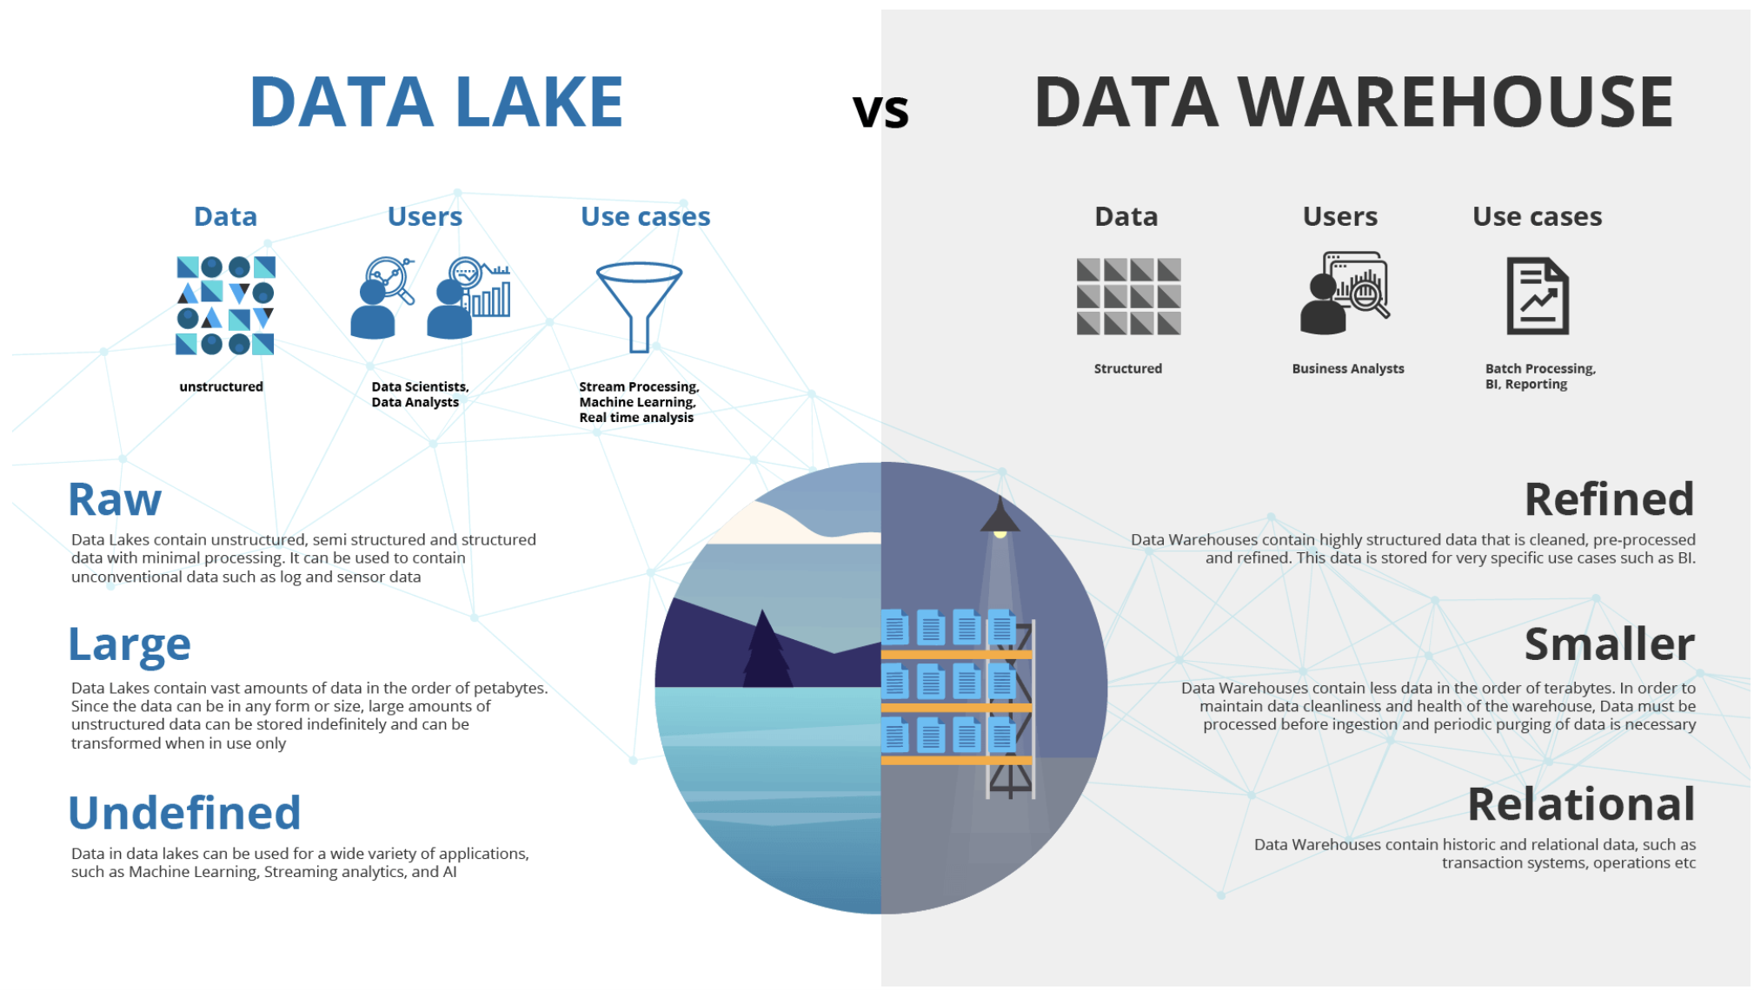
12

Slide 13
Data analysis
Introduction
Data analysis is the process of systematically applying statistical and logical techniques to describe, summarize, and evaluate data. It involves inspecting, cleaning, transforming, and modeling data to discover useful information and support decision-making.
13

Slide 14
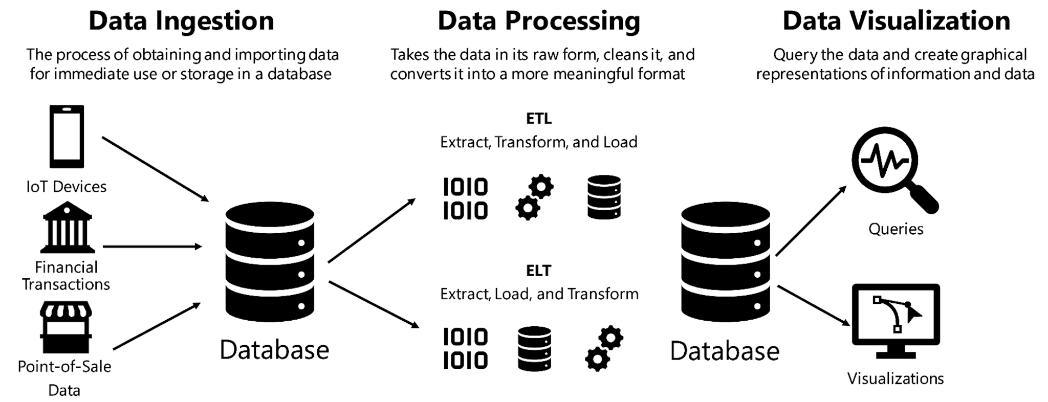
Data Journey
14

Slide 15
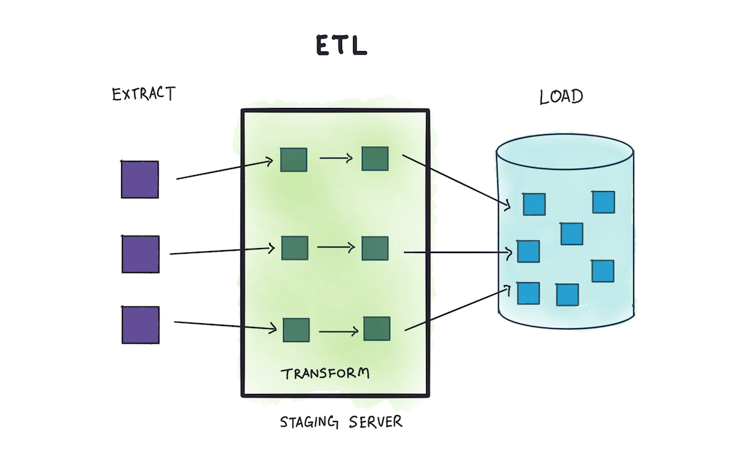
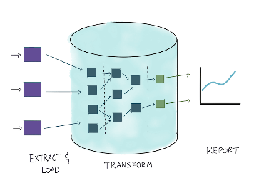
ETL vs ELT
Source: Holistics.io

Slide 16


Data Analysis Use Cases
Question: An e-commerce company wants to determine which products sell best?
Data Analysis:
They collect data on orders, revenue, sales volume, and purchase times.
After analyzing, they discover that discounted products generate higher revenue on weekends, allowing them to optimize their promotional strategy.
Sales Revenue Analysis
Question: A mobile games company wants to optimize user behavior?
Data Analysis:
A gaming company tracks player behavior: hours played, levels achieved,
and items purchased.
After analysis, they realize that players tend to leave the game when encountering difficult levels.
Based on this insight, they adjust the game's difficulty to retain players longer.
Game User Behavior
16

Slide 17
Data Positions
in a company
and
BI Tools
17

Slide 18
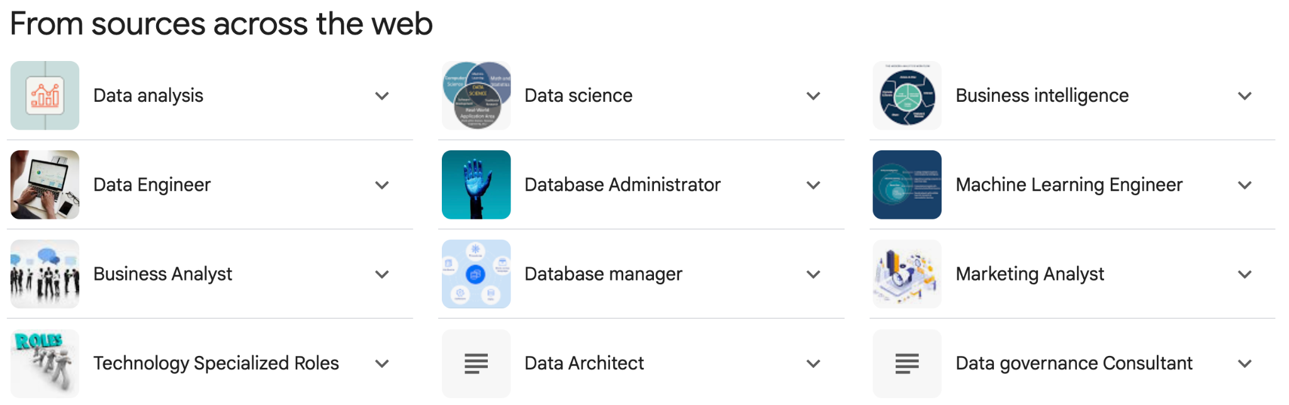
Roles in Data
18
Notes:
Ease to integrate with cloud data warehouses: How simply the BI tool can connect to and retrieve data from cloud-based data warehouses.
Usability and interface: The ease with which users can navigate the software, and the intuitiveness of the user interface.
Automation and notification support: The capability of the BI tool to automate tasks and alert users about specific events or thresholds.
Ease to export and import data: How effortlessly data can be moved in and out of the BI tool, facilitating data sharing and processing.
Speed, Performance, and Responsiveness: The efficiency of the BI tool in processing data and delivering insights, especially with large datasets.
Modeling with Versioning Control: Support for data modeling within the tool, including the ability to manage versions of data models.
Library and Support for Custom Views: Availability of pre-built models and the ability to create custom views to match specific business needs.
Cost: The total expense of implementing and maintaining the BI solution, considering both upfront and ongoing costs.

Slide 19
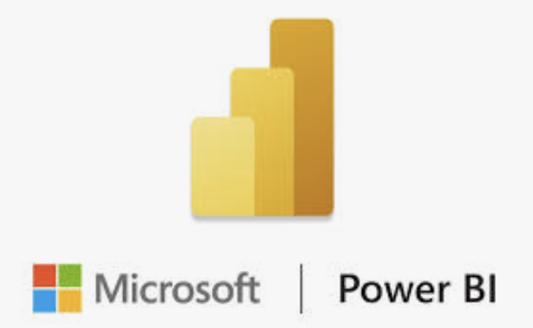




Core BI Tools
1
Visualization Tools
2
SQL
3
Python/R
19
Notes:
Ease to integrate with cloud data warehouses: How simply the BI tool can connect to and retrieve data from cloud-based data warehouses.
Usability and interface: The ease with which users can navigate the software, and the intuitiveness of the user interface.
Automation and notification support: The capability of the BI tool to automate tasks and alert users about specific events or thresholds.
Ease to export and import data: How effortlessly data can be moved in and out of the BI tool, facilitating data sharing and processing.
Speed, Performance, and Responsiveness: The efficiency of the BI tool in processing data and delivering insights, especially with large datasets.
Modeling with Versioning Control: Support for data modeling within the tool, including the ability to manage versions of data models.
Library and Support for Custom Views: Availability of pre-built models and the ability to create custom views to match specific business needs.
Cost: The total expense of implementing and maintaining the BI solution, considering both upfront and ongoing costs.

Slide 20
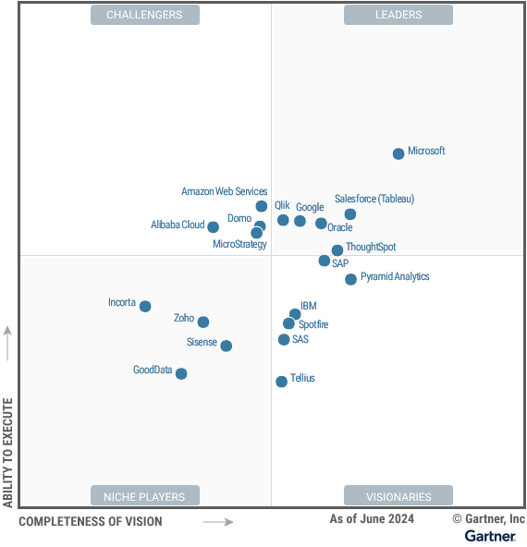
Core BI Tools
20

Slide 21
Installing
Power BI:
https://www.microsoft.com/en-us/download/details.aspx?id=58494/
Azure Data Studio:
https://learn.microsoft.com/en-us/azure-data-studio/download-azure-data-studio?tabs=win-install%2Cwin-user-install%2Credhat-install%2Cwindows-uninstall%2Credhat-uninstall
Google Cloud Bigquery
https://cloud.google.com/bigquery?hl=en
21

Slide 22

fullstackdatascience.com
References
https://www.holistics.io/books/setup-analytics/etl-vs-elt-what-s-the-big-deal/
https://www.holistics.io/blog/etl-vs-elt-how-elt-is-changing-the-bi-landscape/
https://www.kimballgroup.com/data-warehouse-business-intelligence-resources/kimball-techniques/kimball-data-warehouse-bus-architecture/
https://hbr.org/2012/10/data-scientist-the-sexiest-job-of-the-21st-century
22

Slide 23





Thank you
096 574 90 25
CREATED BY
Nguyen Tien Huy
info@robusto.ai
fullstackdatascience
huynt@fullstackdatascience.com
Data Manager
https://fullstackdatascience.com/
Hanoi, Vietnam

